Slide 1
Overview of Databases
Notes:
What is a database? It’s an organized collection of information

Slide 2
IN THIS MODULE WE ARE GOING TO SEE :
WHAT ARE DATABASES?
PHPMYADMIN SERVER FOR MYSQL
RUN SQL QUERIES
CREATE TABLES
AGGREGATE FUNCTIONS
ACTIVITIES ON SQL
TOO MUCH INFORMATION???
BREAKS IN BETWEEN!!!!

Slide 3
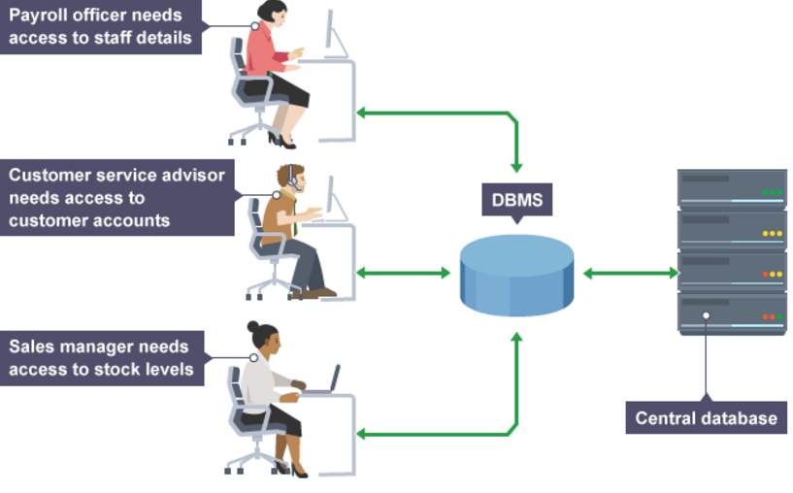
Database Management System (DBMS)
DBMS is a set of software programs
Allows you to store, modify, retrieve, and manage data in databases
Is both convenient and efficient to use
The DBMS provides a centralized view of data that can be accessed and organized by multiple users from multiple locations
Notes:
Instead of storing the data on many different files on multiple computers, all the data can be stored and shared using the DBMS.
You might lose files or have trouble finding them by using a file system to store your data.
Users send requests for info to the DBMS, DBMS processes the request and gets the information from the database, the DBMS then gives the info to the users.
Database Applications:
Banking: transactions
Airlines: reservations, schedules
Universities: registration, grades
Sales: customers, products, purchases
Databases touch all aspects of our lives

Slide 4
DATA IS THE NEW WEALTH
What do you think about the pros and cons associated with this?

Slide 5
Imagine Walmart wants to target the electronics market!
What do you think they can do with database queries?

Slide 6
Analyse and track the sales of electronics, how often they sell, product characteristics etc.
Specificity is the key

Slide 7
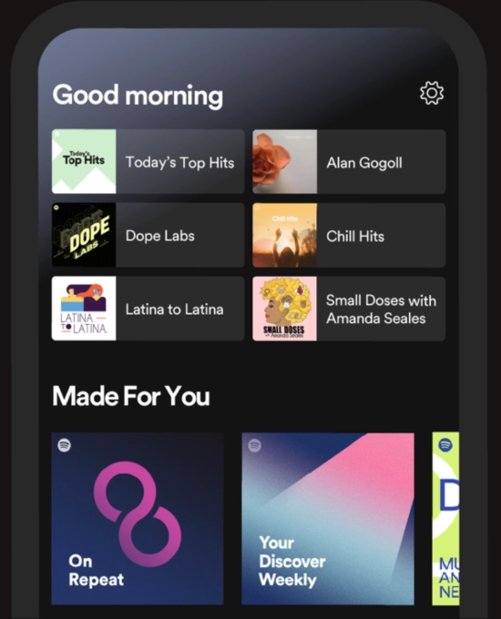
Spotify has the collection of music I listen to everyday, customizes it for me with ON REPEAT album, YOUR RECENT FAVORITES album and a lot more.
Other examples

Slide 8
CAN YOU THINK OF EXAMPLES OF DATABASES THAT IS BEING USED EXTENSIVELY IN THE CURRENT ERA?

Slide 9
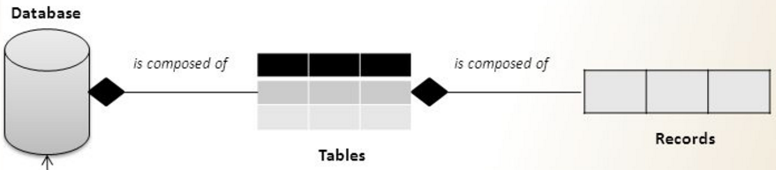
A Sample Relational Database
Notes:
In RDBMS the tables are related to each other
A record is a row of data and is each individual entry that exists in a table
The RDBMS we’ll be using is called MySQL

Slide 10
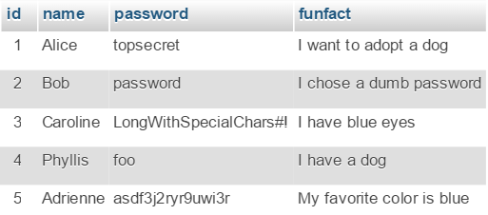
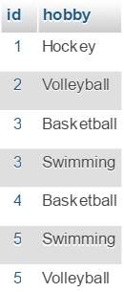
A Sample Relational Database
People Table
Hobbies Table
Notes:
A column contains all information associated with a specific field/attribute in a table
RDBMS organizes data into tables of rows and columns, with a unique key for each row.
We can access the data by writing queries to request the info we want. Since our DBMS is a relational one, we will be using SQL to write our queries. SQL (Structured Query Languge) is a programming language for accessing, defining, and updating data in a RDBMS.
In an RDBMS, data is organized as independent tables. Relationships among tables are shown through shared data.
The IDs in the hobbies table are referencing the IDs in the people table

Slide 11
Try It
Open the chrome browser on FastX and type https://stem-db.poly.edu/phpmyadmin/
Open up the phpMyAdmin and login.
The usernames are - stemdbuser1 and the password is nyuK12stem!1 (replace 1 with 2 for group 2)
Once you have logged in you can see a Database name stemdb1/stemdb2 in the top left side.
stemdb is called a Database as it contains a collection of different tables which you can see.
Now let’s create our own tables and explore some existing tables in our stemdb1/stemdb2 database.
AWESOME!
Notes:
phpMyAdmin is a web app that provides a GUI to work with the MySQL DBMS so you can manage your databases easily. You can use it to create, modify, or delete databases, tables, fields or rows; and also execute SQL statements

Slide 12
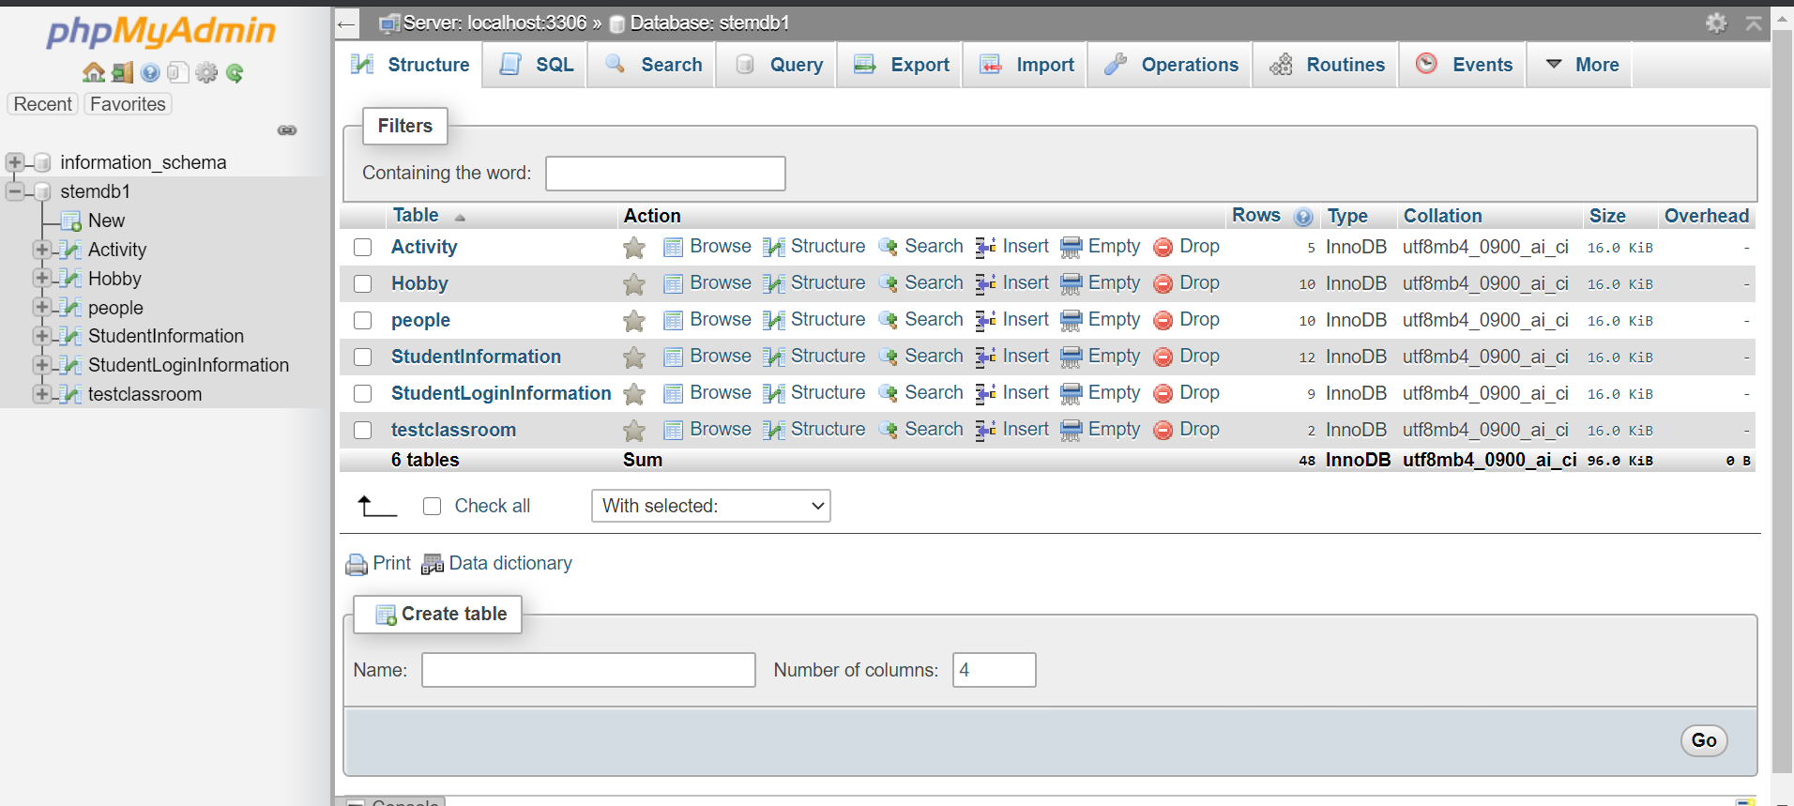
Notes:
Ask students how many columns they see.
What are the columns they see.
What can be the type of Data in each column.

Slide 13
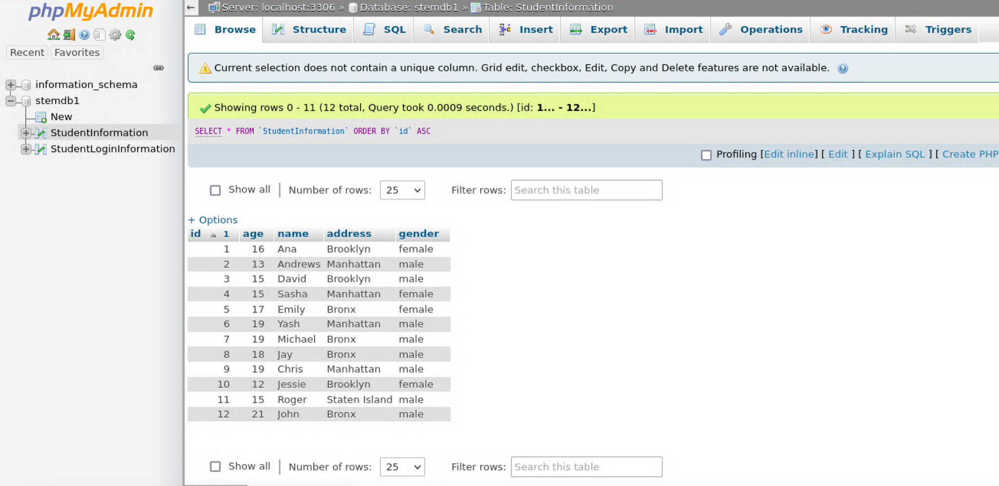

Slide 14
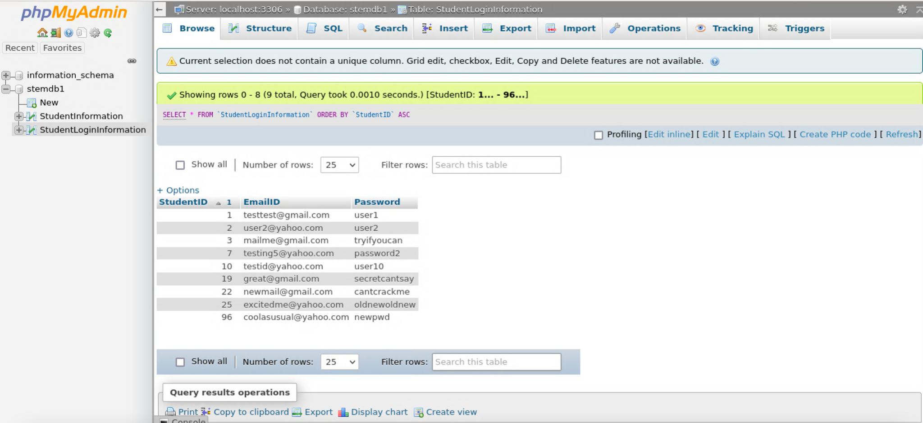

Slide 15
Typical SQL query has the form:
SELECT A1, A2,
FROM R1,R2,
WHERE P

Slide 16
BASIC SQL COMMANDS
SELECT - extracts data from a database
UPDATE - updates data in a database
DELETE - deletes data from a database
INSERT INTO - inserts new data into a database
CREATE TABLE - creates a new tabl

Slide 17
The SQL FROM Clause
FROM - The FROM command is used to specify which table to select or delete data

Slide 18
The SQL WHERE Clause
The WHERE clause is used to filter records.
The WHERE clause is used to extract only those records that fulfill a specified condition.

Slide 19
* (Asterisk) in SQL
Derived from this mathematical "set-theory" concept, in SQL, * simply means to select all fields of the table or result set.

Slide 20
JUST LIKE PYTHON THE SQL COMMANDS ARE EASILY READABLE AND IS USER FRIENDLY!!

Slide 21
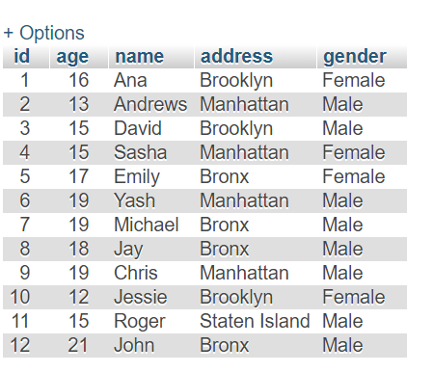
Let’s start running some queries
Display the Name of all Male Students.
StudentInformation Table(No space in the table name)

Slide 22
SQL
SELECT Name
FROM StudentInformation
WHERE gender=’Male’
Display the Name of all Male Students.
StudentInformation

Slide 23
SQL
Display all student information for all students who are older than 14.
StudentInformation

Slide 24
SQL
SELECT * FROM StudentInformation
WHERE age > 14
Display all student information for all students who are older than 14.
StudentInformation

Slide 25
BREAK TIME

Slide 26
Wildcards
A wildcard character is used to substitute any other character(s) in a string.
Wildcard characters are used with the SQL LIKE operator.
The LIKE operator is used in a WHERE clause to search for a specified pattern in a column.
There are two wildcards used in conjunction with the LIKE operator:
% - matches one or more characters
_ -matches one character

Slide 27
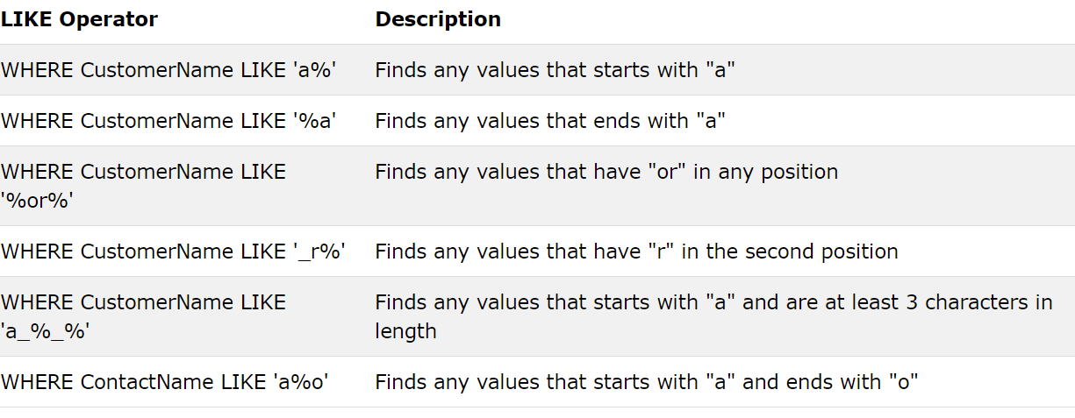
SOME EXAMPLES ON HOW TO USE THEM

Slide 28
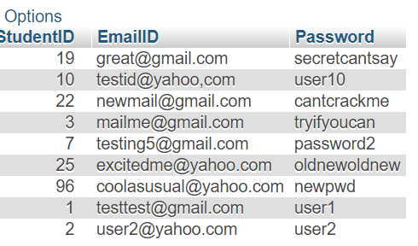
LET’S SOLVE A QUESTION NOW
Find the Student ID’s of all students who have a gmail account from table StudentLoginInformation.
This is the table->

Slide 29
SQL (cont.)
Find the Student ID’s of all students who have a gmail account
SELECT * FROM StudentLoginInformation WHERE EmailID LIKE '%gmail.com'

Slide 30
Now let us create a table
and see how it looks.
Let’s create a Hobby Table with Name, Hobby and Student ID. Fill in the values yourself.
CREATE TABLE table_name (
column1 datatype,
column2 datatype,
column3 datatype,
....
);
Notes:
Demo create table but let students insert their value

Slide 31
Now let us create a table
and see how it looks.
Let’s create a Hobby Table with Name, Hobby and Student ID. Fill in the values yourself.
Answer:
CREATE TABLE Hobbies (StudentID varchar(6), Name varchar(255), Hobby varchar(255));

Slide 32
Adding new values into the table:
Open the Table that you just created
Insert more values
HOW?
INSERT INTO Hobbies VALUES ("Your own id", "Your own name", "Your own hobby");

Slide 33
BREAK TIME

Slide 34
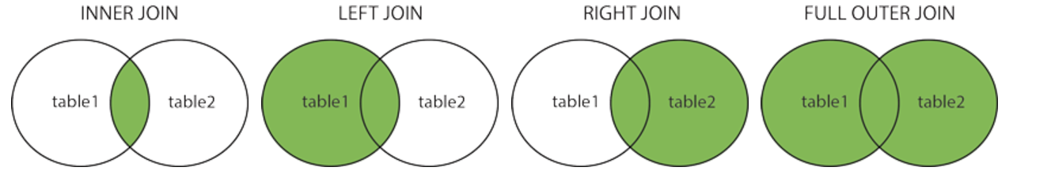
Joins
A JOIN clause is used to combine rows from two or more tables, based on a related column between them.
Here are the different types of the JOINs in SQL:
(INNER) JOIN: Returns records that have matching values in both tables
LEFT (OUTER) JOIN: Return all records from the left table, and the matched records from the right table
RIGHT (OUTER) JOIN: Return all records from the right table, and the matched records from the left table
FULL (OUTER) JOIN: Return all records when there is a match in either left or right table

Slide 35
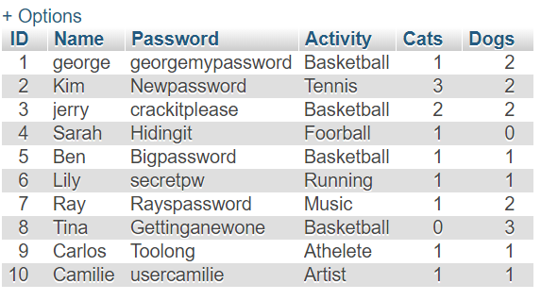
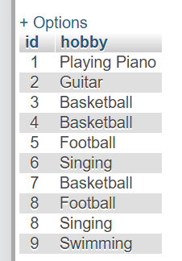
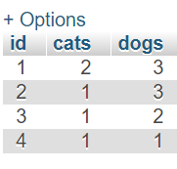
Joins (cont.)
How do we join more than two tables together?
CODE STRUCTURE :
FROM table1 JOIN table2 USING (id)
JOIN table3 USING (id)
People Table
Hobby Table
Pets Table
Notes:
Also maybe have to update

Slide 36
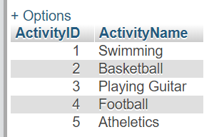
Joins (cont.)
WHERE, USING and ON works the same!
Find each person’s Name, Activity by joining the two tables based on their IDs..
SELECT Name, Activity FROM People JOIN Activity WHERE People.ID=Activity.ActivityID
People Table
Activity Table
Notes:
Maybe have to update

Slide 37
Let us do some questions to learn more about them !
Notes:
We see two tables Student Information and Student Login Information. We will solve some questions to understand how JOIN really works.

Slide 38
Joins (cont.)
Display Email ID, Password, and Name where Student ID matches
on both tables.
StudentInformation
StudentLoginInformation
Notes:
SELECT Student_Information.Name, Student_Login_Informataion.EmailID, Student_Login_Informataion.Password FROM Student_Information JOIN Student_Login_Information ON Student_Information.StudentID = Student_Login_Information.StudentID

Slide 39
Joins (cont.)
Display Email ID, Password, and Name where Student ID matches
on both tables.
SELECT StudentInformation.name, StudentLoginInformation.EmailID, StudentLoginInformation.Password
FROM StudentInformation JOIN StudentLoginInformation ON StudentInformation.id =
StudentLoginInformation.StudentID
StudentInformation
StudentLoginInformation
Notes:
SELECT Student_Information.Name, Student_Login_Informataion.EmailID, Student_Login_Informataion.Password FROM Student_Information JOIN Student_Login_Information ON Student_Information.StudentID = Student_Login_Information.StudentID

Slide 40
Joins (cont.)
Display Name where Student ID matches
on both tables.
Student Information
Student Login Information

Slide 41
Joins (cont.)
Display Name where Student ID matches
on both tables.
SELECT StudentInformation.name
FROM StudentInformation JOIN StudentLoginInformation ON StudentInformation.id =
StudentLoginInformation.StudentID
Student Information
Student Login Information

Slide 42
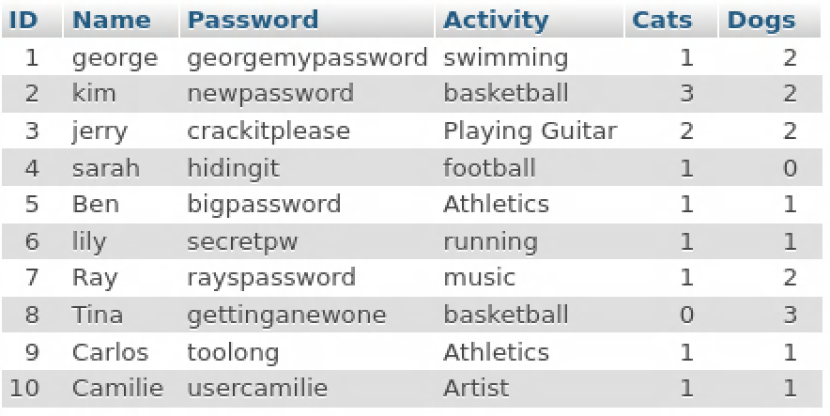
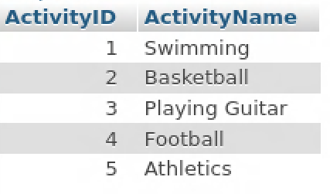
Joins (cont.)
Find each person’s Name, Activity by joining the two tables based on their IDs..
People Table
Activity Table

Slide 43
Joins (cont.)
Find each person’s Name, Activity by joining the two tables based on their IDs..
SELECT Name, ActivityName
FROM People JOIN Activity ON ID = ActivityID
People Table
Activity Table

Slide 44
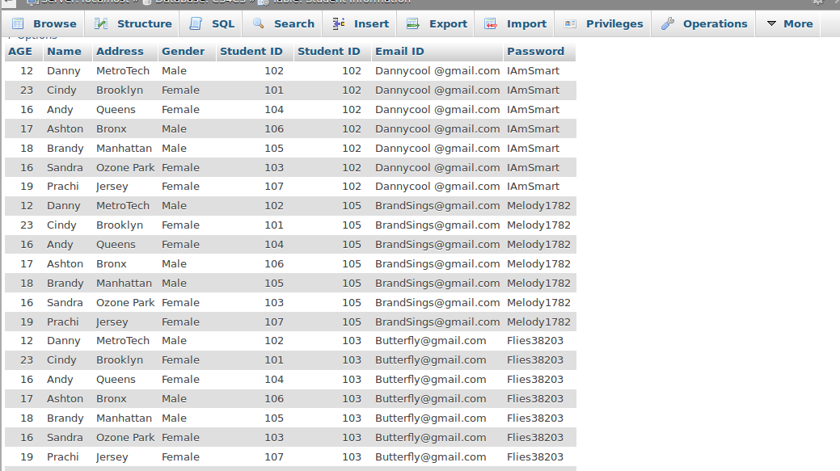
Joins (cont.)
Beware of cartesian product!
SELECT * FROM `StudentInformation` JOIN `StudentLoginInformation`
Notes:
Concatenates by linking the tables to each other

Slide 45
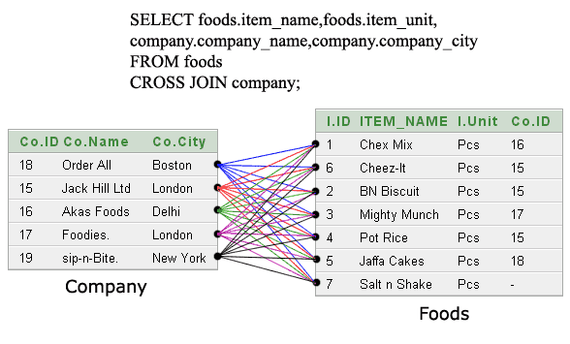
Cartesian product

Slide 46
SQL in a Nutshell
SELECT <list of attributes> FROM <list of tables or joins of tables>
WHERE <condition that the rows should satisfy to land in your result>
Some fancier stuff:
Arithmetic Operations
Add (+), Subtract (-), Multiply (*), Divide (/), Modulo (%)
Group and aggregate data
GROUP BY
SUM
Complicated queries with subqueries

Slide 47
Aggregate Functions
Values from multiple rows are grouped together as input to form single value
Example:
Count()
Sum()
Avg()
Min()
Max()

Slide 48
Aggregate Functions (cont.)
Find the total number of dogs and cats people own
People Table

Slide 49
Aggregate Functions (cont.)
Find the total number of dogs and cats people own
SELECT SUM(Cats) + SUM(Dogs)
FROM People
People Table

Slide 50
Aggregate Functions (cont.)
Find the number of people that like each hobby
Hobby Table
Notes:
How many hobbies does a person have? select name, count(id) from people natural join hobbies where id = 5
The COUNT(*) function returns the number of records in a table:

Slide 51
Aggregate Functions (cont.)
Find the number of people that like each hobby
SELECT hobby, COUNT(*)
FROM Hobby
GROUP BY hobby
Hobby Table
Notes:
How many hobbies does a person have? select name, count(id) from people natural join hobbies where id = 5
The COUNT(*) function returns the number of records in a table:

Slide 52
Defining the Table Structure
People Table
CREATE TABLE people (
id int(11),
name varchar(20),
password varchar(32),
Activity varchar(240),
PRIMARY KEY (id))
Primary keys uniquely identify each row in a table and is used to help establish relationships between tables
Notes:
Primary key (ID uniquely identifies instructors)

Slide 53
Special Operators
BETWEEN - used to define range limits.
IS NULL - used to check whether an attribute value is null. (Checks for missing data/values)
LIKE - used to check for similar character strings.
IN - used to check whether an attribute value matches a value contained within a (sub)set of listed values.
EXISTS - check whether subquery returns any record

Slide 54
Try Modifying the Database….
INSERT INTO people (.......................)
VALUES (...................)
UPDATE People SET Activity =‘I like ice cream’ WHERE id = 2
DELETE FROM People
WHERE id = 2
Insert names, ids, passwords (not your real ones),
for everyone at your table
Insert some info about your hobbies
Run a few more queries

Slide 55
ACTIVITY TIME

Slide 56
Time to explore and practice:
Try creating your own table
Insert names, ids, passwords (not your real ones), and activities etc. to your table
Insert some info about your hobbies
Run a few more queries
Try to use all the sql commands and functions we have just learned
Explore more and share what you just did

